Slide 1



Weighted Astar How Greedy is Too Greedy?
ME 459
Alex Dowell

Slide 2
Problem Statement…..
Using a weighted A* pathfinding algorithm on a quadcopter, what are the effects on computation time and path optimality in increasingly constrained 3D space with varying weights?

Slide 3
Test Parameters
Holding Constant:
C-space = 91 X 20 X 20
Starting Point of = [ 0 , 0 , 0 ]
Goal Point of = [ 90 , 5 , 2 ]
Varying:
Path constraints by adding 4 layers of obstacles
For each layer run trials for weights of 1, 2, 5, 10, and 1000

Slide 4
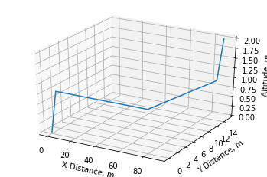
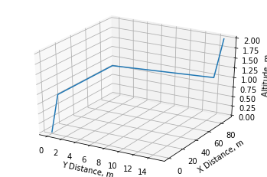
No layers (Direct Line Of sight)
￼
The optimal path cost is: 96.8488 m
Weight = 1 (NO Weight) Path cost = 96.8488 Time to Compute = 10.5379 seconds
Weight = 2 Path cost = 96.8488 Time to Compute = 10.7860 seconds
Weight = 5 Path cost = 96.8488 Time to Compute = 9.9759 seconds
Weight = 10 Path cost = 96.8488 Time to Compute = 10.5829 seconds
Weight = 1000 Path cost = 96.8488 Time to Compute = 10.3139seconds

Slide 5
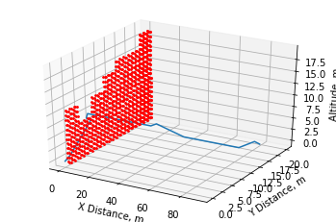
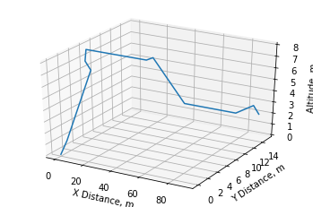
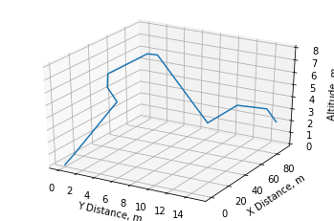
Layer 1
￼
The optimal path cost is: 105.6807 m
Weight = 1 (NO Weight) Path cost = 105.6807 Time to Compute = 22.0799 seconds
Weight = 2 Path cost = 105.6807 Time to Compute = 19.6059 seconds
Weight = 5 Path cost = 105.6807 Time to Compute = 23.4110 seconds
Weight = 10 Path cost = 105.6807 Time to Compute = 23.7709 seconds
Weight = 1000 Path cost = 105.6807 Time to Compute = 23.3079 seconds

Slide 6
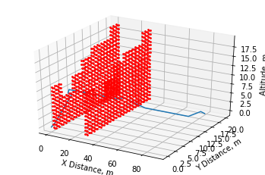
Layer 2
￼
The optimal path cost is: 105.6807 m
Weight = 1 (NO Weight) Path cost = 112.5582 Time to Compute = 29.7999 seconds
Weight = 2 Path cost = 114.6580 Time to Compute = 30.9847 seconds
Weight = 5 Path cost = 115.4864 Time to Compute = 29.2729 seconds
Weight = 10 Path cost = 116.9505 Time to Compute = 29.5680 seconds
Weight = 1000 Path cost = 117.7790 Time to Compute = 31.2670 seconds

Slide 7
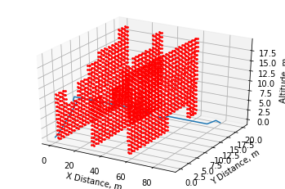
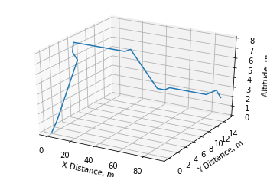
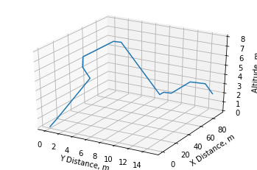
Layer 3
￼
The optimal path cost is: 105.6807 m
Weight = 1 (NO Weight) Path cost = 112.5582 Time to Compute = 41.3920 seconds
Weight = 2 Path cost = 114.6580 Time to Compute = 43.3239 seconds
Weight = 5 Path cost = 115.4864 Time to Compute = 41.9139 seconds
Weight = 10 Path cost = 116.9505 Time to Compute = 50.5340 seconds
Weight = 1000 Path cost = 117.7790 Time to Compute = 40.7965 seconds

Slide 8
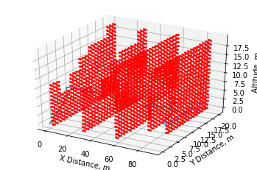
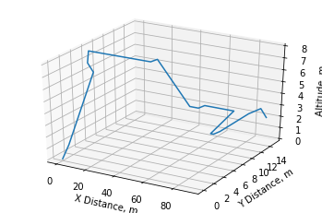
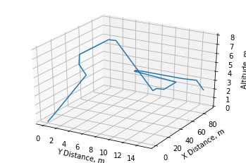
Layer 4
￼
The optimal path cost is: 114.9944 m
Weight = 1 (NO Weight) Path cost = 123.5288 Time to Compute = 51.1589 seconds
Weight = 2 Path cost = 126.4570 Time to Compute = 51.4984 seconds
Weight = 5 Path cost = 127.2854 Time to Compute = 53.4080 seconds
Weight = 10 Path cost = 128.7495 Time to Compute = 53.4882 seconds
Weight = 1000 Path cost = 129.5780 Time to Compute = 54.4770 seconds

Slide 9
Results
With little to no obstructions added weights did not affect cost and have a narrow range of weights, between 1 and 10, that proved to provide a computation time benefit.
Increasing obstructions had a substantial effect on path cost
All layer sets had showed evidence that there is an optimal weight except for layer for configuration
This could be because a more thorough analysis needed to be done on layer 4 configuration, exploring more and/or broader range of weights
---or---
Layer 4 could have reached a threshold of constraints such that adding a weight would have a negative effect

Slide 10
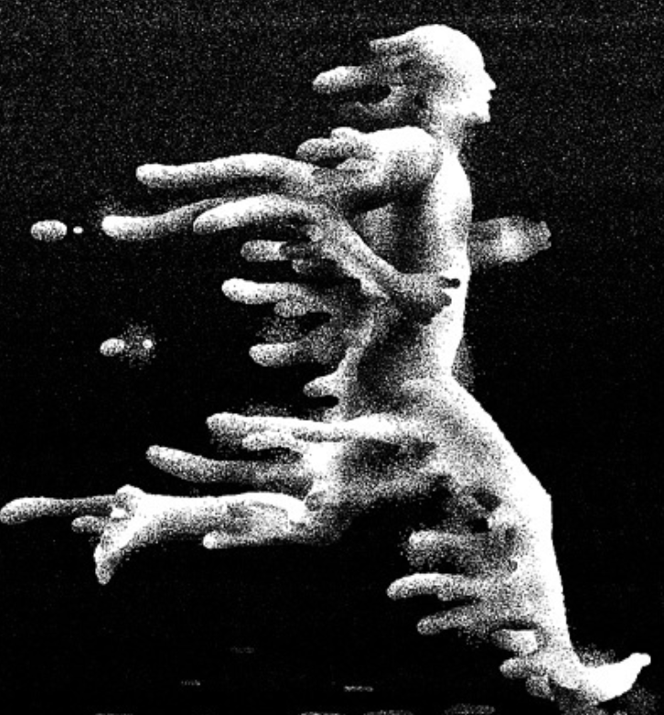
Conclusion
It’s the classic story of Icarus in Greek mythology
A* tried to lift increasingly more weight and tried to traverse an increasingly more complex space, but it turns out that weight was of wax.

Slide 11
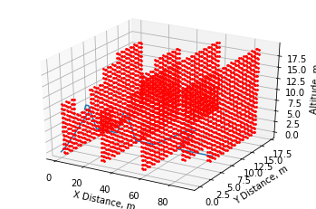
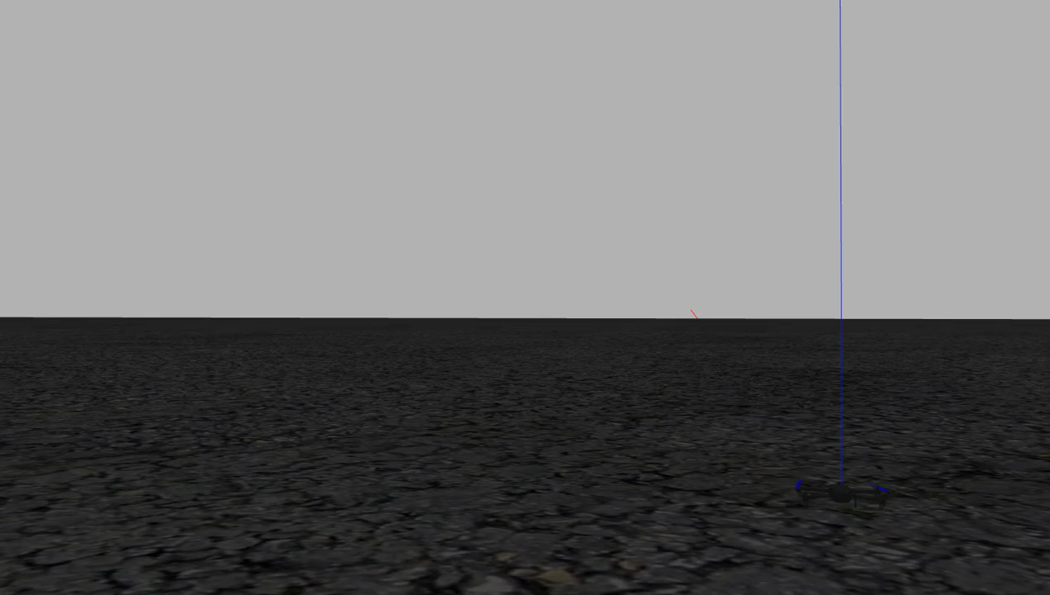
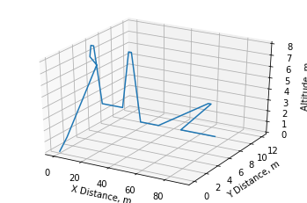
Simulation of a quadcopter weight = 5

